Slide 1
Freetube testing
Balan Mircea

Slide 2
What is Freetube? https://github.com/FreeTubeApp/FreeTube
Freetube is an open source Youtube front end desktop client that uses Invidious to deliver content
Invidious in essence is an extractor that obtains data from YouTube.
The extractor selects the data in such a way that the client (Freetube in this case) only receives the absolute essential data (the video itself, number of views, upload date, channel page and so on)
Benefits:
No ads
Youtube’s/Google’s JS tracking scripts cannot track you, privacy friendly
This makes Freetube very lightweight on resources
Don’t need a Google account to favourite videos, subscribe to channels and so on that would require an actual account on YT.com

Slide 3
How was it approached?
The first step was reading the Github page of the application. To understand what it’s supposed to do, which features are supposed to be in the latest beta release and so on.
This was follow by a mixture between ad-hoc testing and exploratory testing
Third step was creating a mindmap
Fourth step was writing the test cases and creating a test data set
Fifth step was test execution
Bug reporting in Mantis
Test report
Various miscellaneous tweaks (eg Editing bug reports to include the test ID)

Slide 4
Tools used
Desktop computer as testing environment
Tested it only on a Linux based OS
Used MS Excel and ONLYOFFICE Spreadsheet to write the test cases
MS Word and ONLYOFFICE Document to write the test reporting
Xmind for the mind map
Firefox to access Mantis
MS PowerPoint to make the presentation
Youtube’s subscription list export feature for test data set

Slide 5
Testing types used
Exploratory testing
Ad hoc testing
Accessibility testing
Localization testing
Positive testing
Performance testing
End to end testing
Functional testing

Slide 6
Test case overview
Profile creation and management
Search function
Subscription management
Channels tab
Trending tab
Playlist tab
History function
About tab
Channel page
Video player
Accessibility testing
Performance testing

Slide 7
Bugs overview
A major bug is Test Case ID 124 / Bug Report 0045221
Playlists do not have a favorite/save button therefore they cannot be saved in the Playlist tab feature. This makes the feature itself almost pointless
A normal bug is Test Case ID 161 / Bug Report 0045224
The video filter feature in the channel page doesn’t function at all. Sorting the video list from oldest to newest does not sort it at all
A minor bug is Test Case ID 135 / Bug Report 0045224
The history tab does not have a refresh button. Therefore there’s no way to refresh the tab without exiting tab and opening it again.

Slide 8
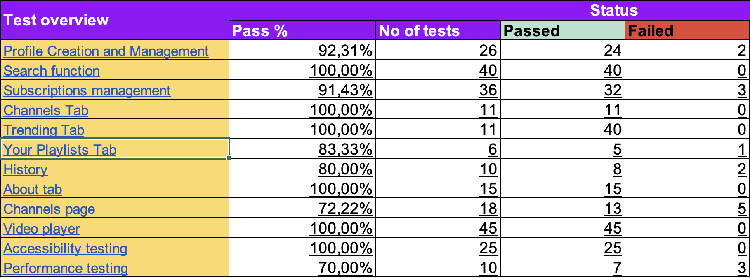
Test cases result
A total of 281 test cases of which only 16 of them failed
11 of those bug are of normal severity
3 of those are of minimal severity
2 of those are of major severity

Slide 9
Conclusion
Despite having some some bugs the application is still functional, especially considering that it’s still in beta. The essential features work correctly such as the video player and search function.
From 251 test cases a total of 235 were successful.
There are 16 remaining bugs with a varied severity level

Slide 10
Lessons learned
The whole testing process is a lot more complicated than initially expected
9/10 the bugs are hidden in plain sight and are basic features that normally developers don’t spend a lot of time working on them due to their simplicity
Trying to test everything within a time limit is not possible, you must concentrate on the important features first
Mindmaps help a lot when it comes to writing test cases and it’s a clear time saver as opposed of just trying to figure it out on the go
You really need to understand what you’re testing

